Slide 1
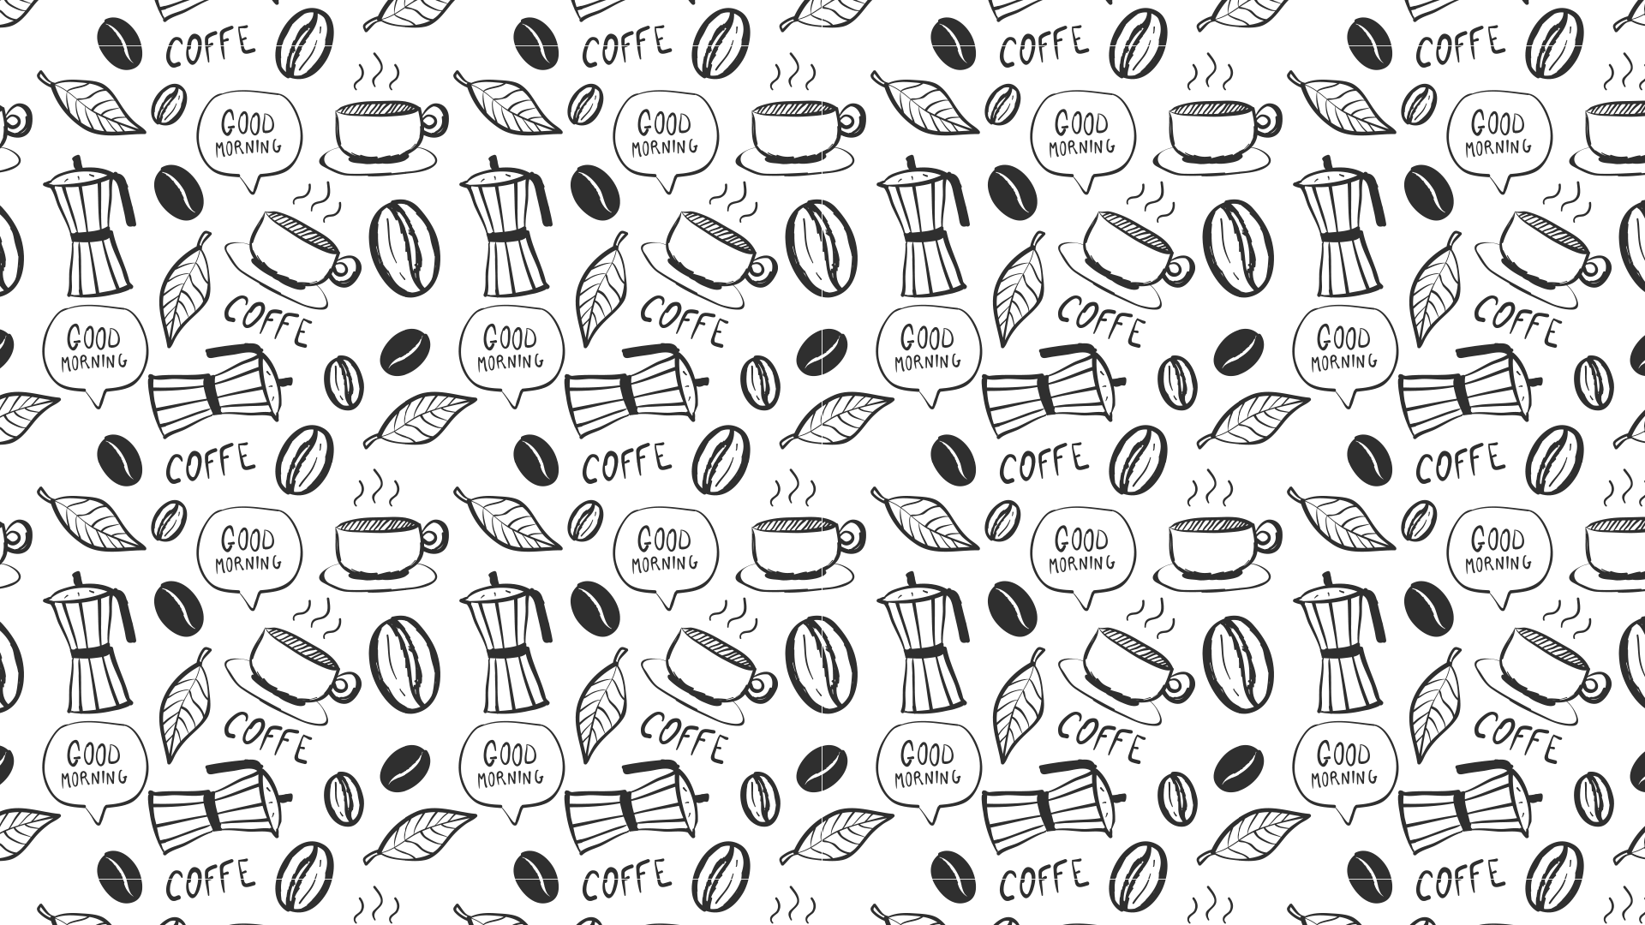

Slide 1
CSE4001- Cloud Computing
Employees begin each day with their chosen coffee in every workplace throughout the globe. The usual procedure is for one employee to go around the table and take each person's coffee order on paper, or for the cafeteria staff to take orders on paper before preparing the coffee .
Team Members
Chaitanya Nagre 20BCN7032
Dhyan 20BCE7648
Gaurav Sharma 20BCE7443
Kasula Rishik 20BCN7011
Nirdesh Singh 20BCE7062
S Pranith 20BCE7388
inefficient and unsustainable.
Waste of manpower
Non eco-friendly
Koffee Ko

Slide 2


Slide 2
OUR BIG IDEA
Employees begin each day with their chosen coffee in every workplace throughout the globe. The usual procedure is for one employee to go around the table and take each person's coffee order on paper, or for the cafeteria staff to take orders on paper before preparing the coffee .
KoffeeKo’s mission is to to assist modernization and eco- friendly practices by providing a platform for the employees throughout the world
Employees will be able to connect to KoffeeKo and enter information about their favourite coffee, and cafeteria staff will be able to read this information and brew the coffee fast.
Inefficient and unsustainable.
Waste of manpower
Non eco-friendly
Green way to start the morning as it does not utilize paper.

Slide 3

Slide 2
Focuses on the visual elements that the user would be able to see.
Software Technology used : Flutter
Platform – Why Mobile App ?
The Solution…
KoffeeKo’s mission is to to assist modernization and eco- friendly practices by providing a platform for the employees throughout the world
KoffeeKo’s mission is to to assist modernization and eco- friendly practices by providing a platform for the employees throughout the world
Employees will be able to connect to KoffeeKo and enter information about their favourite coffee, and cafeteria staff will be able to read this information and brew the coffee fast.
Inefficient and unsustainable.
Waste of manpower
Non eco-friendly
Green way to start the morning as it does not utilize paper.

Slide 4

Slide 3
Focuses on the requests that will be received from the users and sending them back the appropriate data. Here the data will be continuously stored in the cloud.
Software Technology used : Firebase(BaaS)
Requirements
Focuses on the visual elements that the user would be able to see.
Software Technology used : Flutter

Slide 5




Slide 3
Inexpensive
Easy To use
Portability
User-friendly UI
Platform – Why Mobile App ?
Requirements
Focuses on the requests that will be received from the users and sending them back the appropriate data. Here the data will be continuously stored in the cloud.
Software Technology used : Firebase(BaaS)
Focuses on the visual elements that the user would be able to see.
Software Technology used : Flutter

Slide 6
Slide 3
Front-End : Flutter
Platform – Why Mobile App ?
Open Source
Single Codebase
Hot Reload and Development
Native App Like Performance
Requires Less Testing
Use of Custom Widgets
Inexpensive
Easy To use
Portability
Clean UI
KoffeeKo

Slide 7


Cloud - Necessity
The cloud refers to servers that are accessed over the Internet, and the software and databases that run on those servers.
Flutter is Google's portable UI toolkit for crafting beautiful, natively compiled applications for mobile, web, and desktop from a single codebase.
Powered by Dart programming language optimized for mobile apps
It speeds app development and reduces the cost and
complexity of app production across platforms.
High Availability
Scalability
Storage
Reliability
Authentication

Slide 8

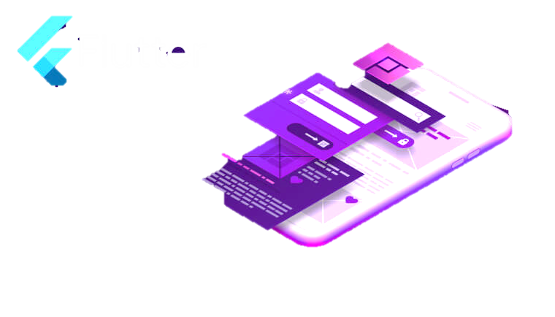
Slide 5
Front-End : Flutter
Flutter is Google's portable UI toolkit for crafting beautiful, natively compiled applications for mobile, web, and desktop from a single codebase.
Powered by Dart programming language optimized for mobile apps
It speeds app development and reduces the cost and
complexity of app production across platforms.

Slide 9
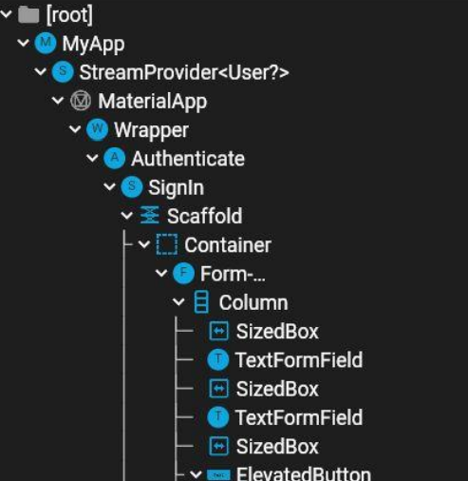
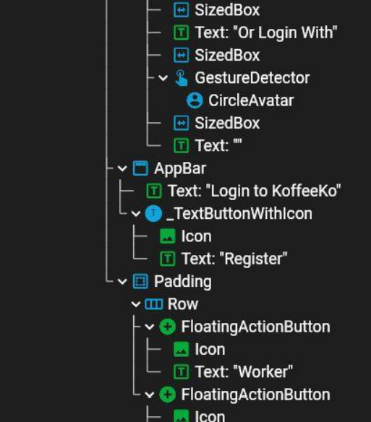
Slide 5
Front-End : Flutter
Open Source
Single Codebase
Hot Reload and Development
Native App Like Performance
Requires Less Testing
Use of Custom Widgets

Slide 10
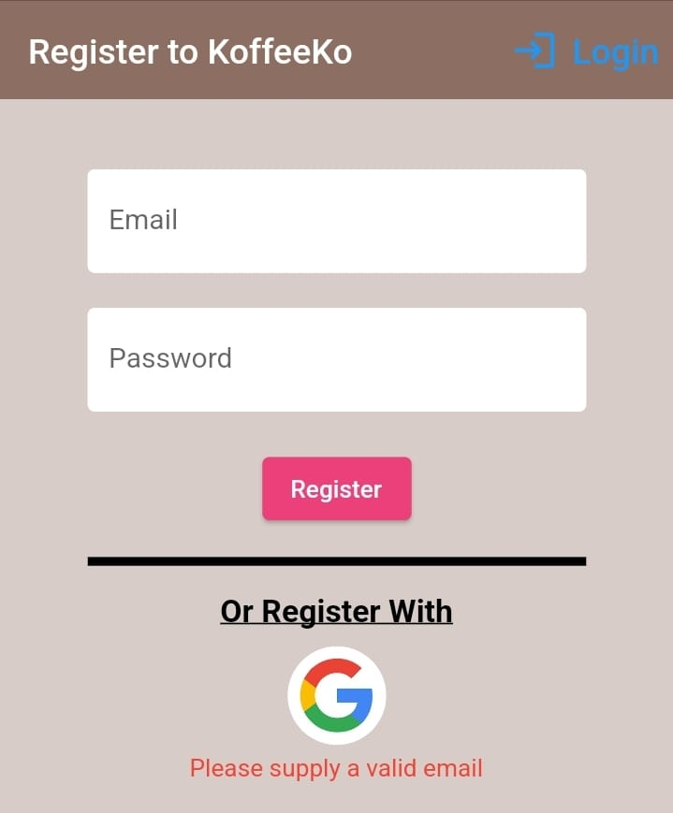
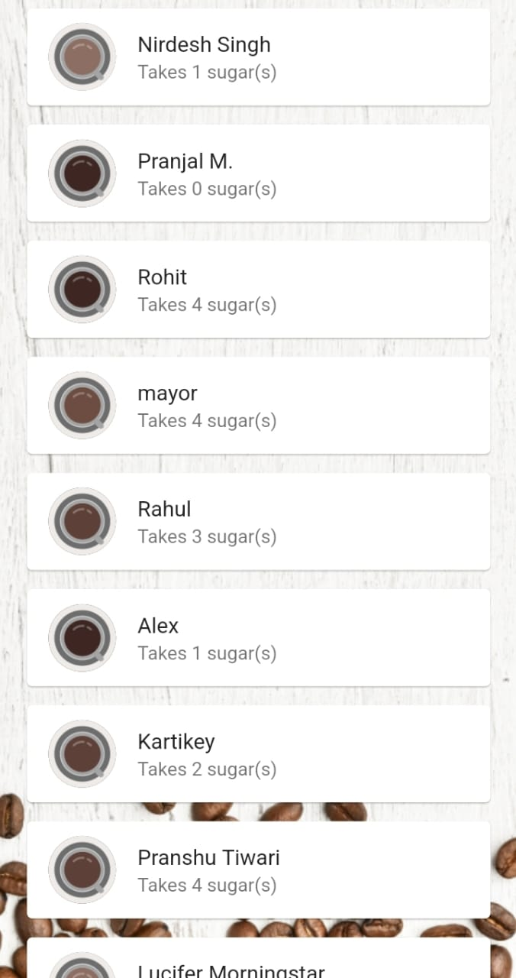
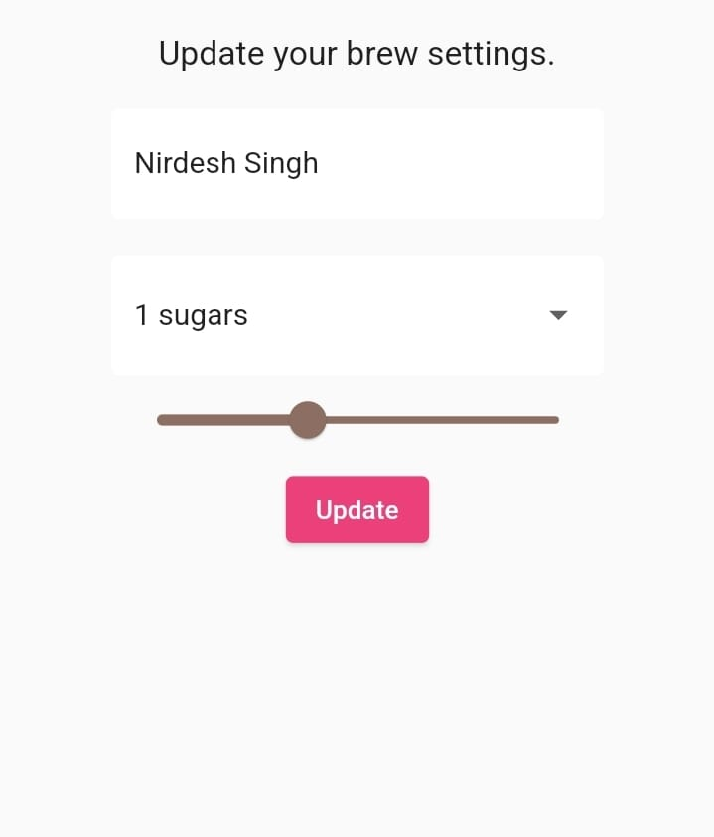
Slide 4
Implementation
Widget Tree
Register/ Login Page
Home Page
Coffee Preference

Slide 11
Slide 7
Application Interface
Register/ Login Page
Home Page
Coffee Preference
The user logs into the app using their user credentials. If any new user comes, they will have to register onto this app.
Login: To be able to log in securely, a user is required to give correct username and password.
Account Authentication: We make signing into our app secure by default.

Slide 12
Slide 7
Register/ Login Page
The user logs into the app using their user credentials. If any new user comes, they will have to register onto this app.
Login: To be able to log in securely, a user is required to give correct username and password.
Account Authentication: We make signing into our app secure by default.
Once, the details are verified, the user has set his/her preference for the coffee.
The user can set a coffee preference for a particular strongness as well as number of sugar cubes.
The registered users can see their names on the home screen.

Slide 13
Slide 7
The user logs into the app using their user credentials. If any new user comes, they will have to register onto this app.
Login: To be able to log in securely, a user is required to give correct username and password.
Account Authentication: We make signing into our app secure by default.
Home Page
The users can change their preferences like name, the strongness of coffee by slider bar.
They may also update their number of sugar cubes.
The user can also delete the details of the preferences that are no longer available and running.
Once, the details are verified, the user has set his/her preference for the coffee.
The user can set a coffee preference for a particular strongness as well as number of sugar cubes.
The registered users can see their names on the home screen.

Slide 14
Slide 7
Once, the details are verified, the user has set his/her preference for the coffee.
The user can set a coffee preference for a particular strongness as well as number of sugar cubes.
The registered users can see their names on the home screen.
Coffee Preference
The users can change their preferences like name, the strongness of coffee by slider bar.
They may also update their number of sugar cubes.
The user can also delete the details of the preferences that are no longer available and running.
Firebase is a cloud service designed to power real-time, collaborative applications.
Simply add the Firebase library to your application to gain access to a shared data structure
changes made to that data are automatically synchronized with the Firebase cloud and with other clients within milliseconds.

Slide 15


Slide 6
Back-End : Firebase
Firebase is a cloud service designed to power real-time, collaborative applications.
Simply add the Firebase library to your application to gain access to a shared data structure
changes made to that data are automatically synchronized with the Firebase cloud and with other clients within milliseconds.

Slide 16


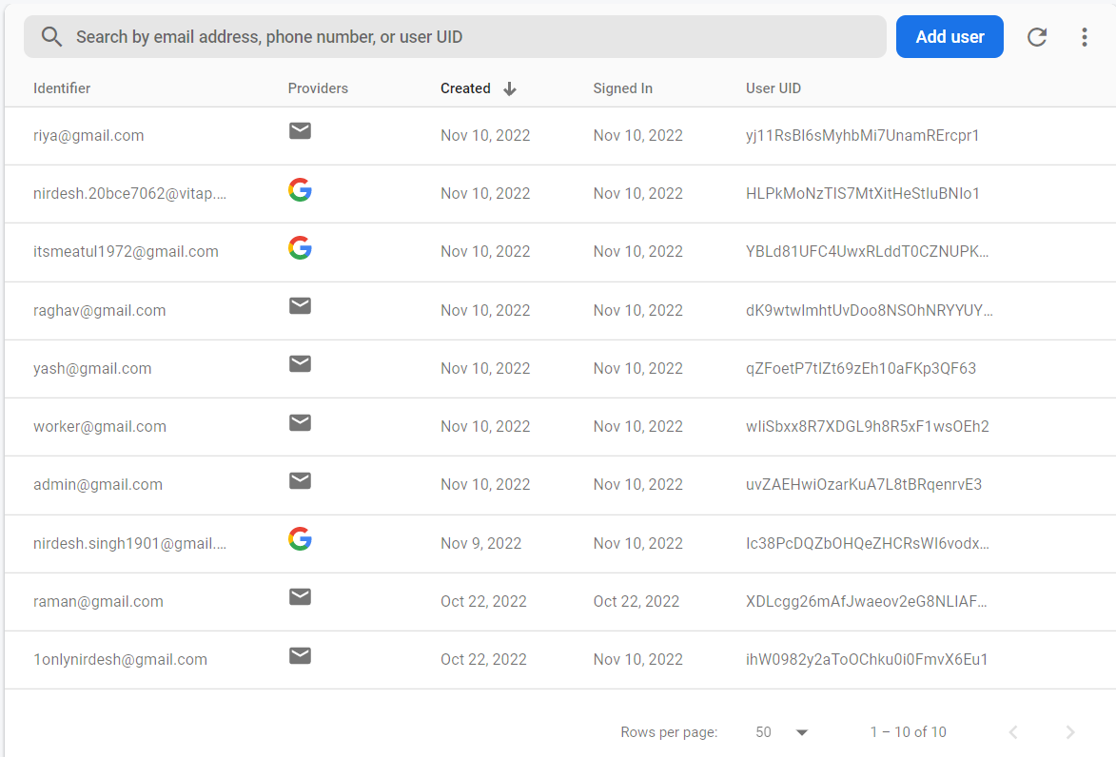






Slide 8
Why Firebase over other platforms
Storage
Hosting
Authentication
Firebase M L
Realtime Database
Crash Reporting
Developer Friendly

Slide 17
Slide 9
Authentication
Authentication
Cloud Firestore is a NoSQL, document-oriented database.
There are no tables or rows.
We store data in documents, which are organized into collections.
Each document contains a set of key-value pairs.

Slide 18

Slide 10
Brews
Cloud Firestore
Cloud Firestore is a NoSQL, document-oriented database.
There are no tables or rows.
We store data in documents, which are organized into collections.
Each document contains a set of key-value pairs.

Slide 19
Slide 11
Schema (Cloud Firestore)
Collection
Sub-Collection(Brews)
Document(UID)
Brews
UID
Name(varchar)
Strength(integer)
Sugars(varchar)

Slide 20
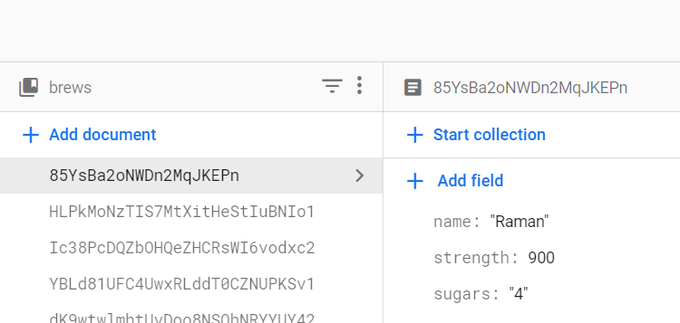
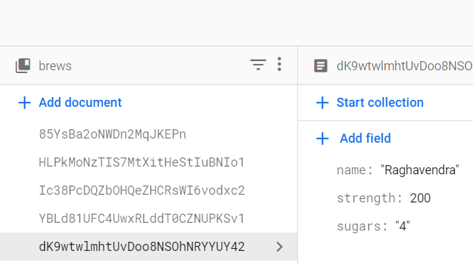
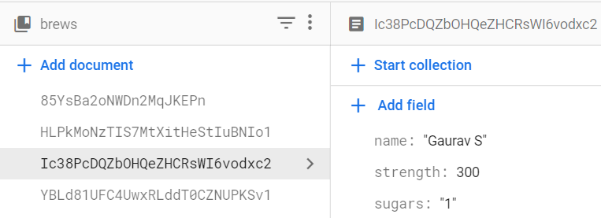
Slide 11
Schema (Cloud Firestore)
Brews

Slide 21
Slide 12
Business Logic
Pricing
Any organization that avails the benefits of KofeeKo will be charged with a percent based on the overall users and other usage criteria.
Bug Fixes
Constant bug fixes and updates for performance improvements and new features.
Expansion
Expand and inclusion of other snacks and pleasantries such as tea , biscuits etc.

Slide 22
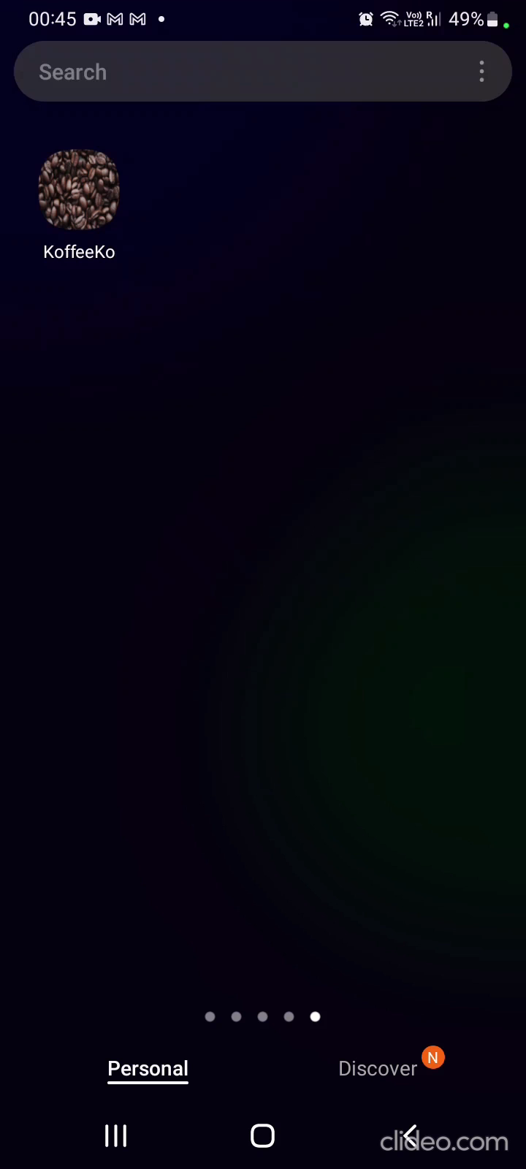
Slide 15
Live Demonstration

Slide 23

Slide 15
THANK YOU!

